Slide 1


AI integration in Higher Education learning and teaching. Provocations for the everyday ethics of ‘should you’.
Dr Kirstin Stuart James
Dr Alisha Aman
GAINEd Network, College of MVLS

Slide 2

Lord Kelvin 200
In 2024 the University of Glasgow marked the 200th anniversary of pioneering scientist William Thomson, Lord Kelvin.
Thomson was Professor of Natural Philosophy at the University of Glasgow from 1846 to 1899.
His discovery work created the science of thermo-dynamics and possible transatlantic communication, features of which [data processing and compression, signal processing and scientific rigour] laid the foundations for AI communication models of today.

Slide 3

Everyday ethics
It is interesting to critically engage with the everyday ethics of AI and Higher Education learning and teaching at the cradle of transatlantic telegraphy-University of Glasgow.

Slide 4
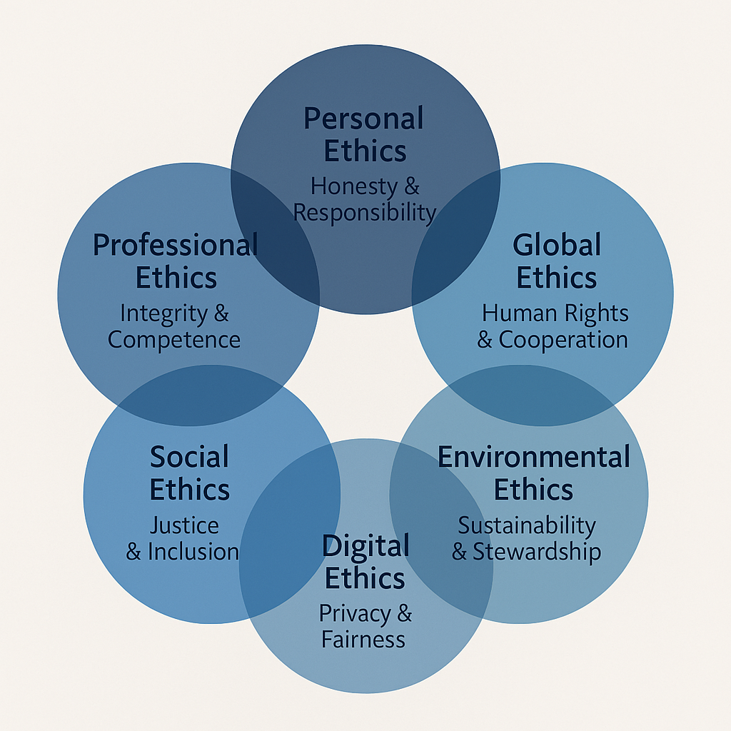
Synthesised framework for everyday ethics
Personal Ethics: Honesty, responsibility, self-discipline
Virtue ethics (eg Aristotle) and human moral development
Professional Ethics: Integrity, competence, confidentiality
Codes of conduct (e.g. The Royal Society of Biology (RSB) has a Code of Professional and Ethical Conduct)
Social Ethics: Justice, inclusion, civic responsibility
Informed by political philosophies (eg theories of justice)
Environmental Ethics: Stewardship, sustainability, intergenerational justice.
Based on ecological philosophy
Digital Ethics: Privacy, data rights, AI fairness, digital well-being
Emerged from information ethics
Global Ethics: Human rights, global justice, peace, cooperation
Influenced by United Nations human rights

Slide 5
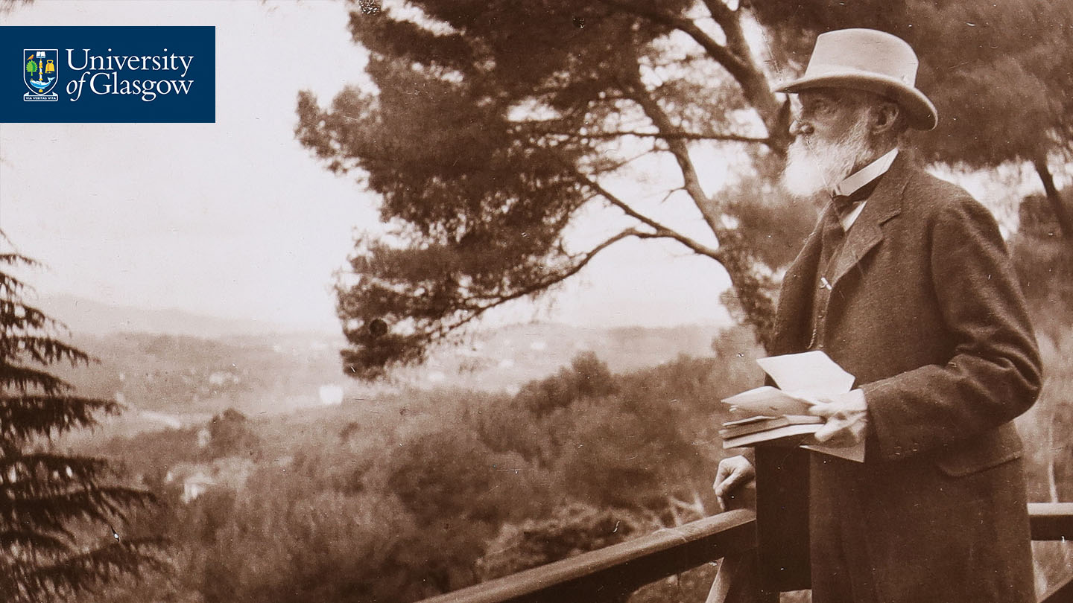
Ethical specific frameworks for provocations
Drawn from two frameworks:
Principles for AI in Scotland: “everyone should contribute to and benefit from AI that is trustworthy, ethical and inclusive”. (Scottish AI Alliance)
Council of Europe Platform on Ethics, Transparency and Integrity in Education (ETINED) Ethical Framework for Teaching in Higher Education

Slide 6
ETINED: Ethical Framework for Teaching in Higher Education
Values-Based Foundations: Align ethics with democracy, human rights, and the rule of law. Promote equity, justice, and inclusion.
Empowering Educators: Tailor ethical codes to local contexts. Reflect shared values and update regularly.
Shared Responsibility: Involve all stakeholders in developing and reviewing codes. Foster ethical awareness.
Sustained Professional Growth: Support lifelong ethical learning. Provide resources and fair enforcement.
Ethical Governance & Global Collaboration: Promote democratic leadership. Balance accountability with ethics. Engage internationally.

Slide 7

Personal ethical provocation: honesty
Big in education!
Authenticity of assessment
Transparency of use in scholarship from all perspectives
‘No AI’ versus enablement of and critical engagement with AI (restrict and punish models)
Professional licensures ‘good conduct’- could impact
Codes of conduct and misconduct
Potential for eroding of trust in relationships

Slide 8

Social ethical provocation: justice
Access inequalities
Marginalisation with AI literacies and digital poverties
Inclusion biases
Scholarship pathologies and unfair outcomes with automation (eg access to human versus AI tutors)
Privileging historically written versus spoken knowledges

Slide 9

Digital ethical provocation: privacy
Open systems
Data privacy
Trustworthiness of agentic systems
Malicious use of data
Cyber crime and security

Slide 10

Final provocation
Remember. AI is not autonomous (yet!!).
WE (humans) are integrating AI into Higher Education.
Should you and at what cost? (planetary costs)

Slide 11




With thanks Questions and comments
#Kelvin200

Slide 12
Further reading and study
‘Future Learn’ Short Course: AI Ethics, Inclusion and Society https://www.futurelearn.com/courses/ai-ethics-inclusion-and-society [‘no cost’ option]
JISC resources: https://www.jisc.ac.uk/innovation/artificial-intelligence
Scottish AI Alliance: https://www.scottishai.com/
Council of Europe Platform on Ethics, Transparency and Integrity in Education: ETINED
Podcast series: Teaching in Higher Ed ; Campus talks: the pros and cons of AI in higher education
Image bank for AI teaching: Scottish AI Playbook resource
[Figures in power point generated by Co-pilot]

